Slide 1
Section 2
Public Kickoff Meeting
Thursday, September 26, 2024
DES 2300291
Notes:
Thank you for your interest in the Tier 2 Mid-States Corridor Study. We appreciate you joining us as we begin work in the area of Dubois County known as Section 2.

Slide 2
PROJECT TEAM
KYANNA WHEELER
Project Manager,
INDOT
JASON DUPONT
Project Manager,
Lochmueller Group
MATTHEW BULLOCK
Deputy Project Manager,
INDOT
JEREMY KIEFFNER
Deputy Project Manager,
Lochmueller Group
MICHELLE HERRELL
FHWA Representative
DAVID GOFFINET
Public Outreach Lead,
Lochmueller Group
NICOLE MINTON
Project Spokesperson, Lochmueller Group
Notes:
Our project team received notice to proceed on Section 2 this summer.

Slide 3
PROJECT OVERVIEW
Notes:
Before we discuss what to expect in Tier 2, let’s review some of the decisions made in Tier 1.

Slide 4
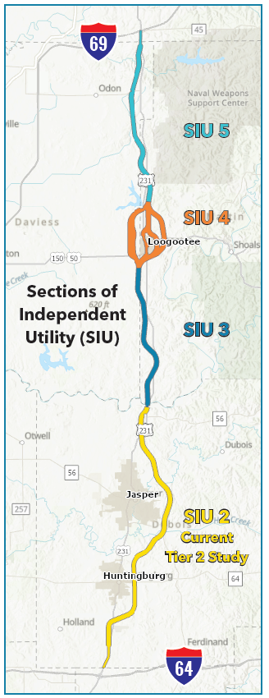
PROJECT OVERVIEW
Tier 1 Decisions
2,000 ft wide corridor approved for development of new corridor
Access roads/connections could extend outside of the corridor
Overall corridor improvements from I-64 to I-69 near Crane
Notes:
The Tier 1 Final Environmental Impact Statement identified the location of the 2,000-foot-wide corridor which begins near I-64, travels east of Huntingburg and Jasper, and connects to I-69.
For Tier 2, the corridor was divided into Sections of Independent Utility. Each section will be studied individually. Section 2 is the first study to be launched. Timelines for the other sections have not been determined at this time.

Slide 5
CORE GOALS OF THE CORRIDOR
Increase accessibility to major business markets
Provide more efficient truck/freight travel in southern Indiana
Increase access to major intermodal centers from southern Indiana
Notes:
Tier 1 identified some corridor wide goals including:
Increase accessibility to major business markets
Provide more efficient truck travel in southern Indiana
And increase access to major intermodal centers from southern Indiana

Slide 6
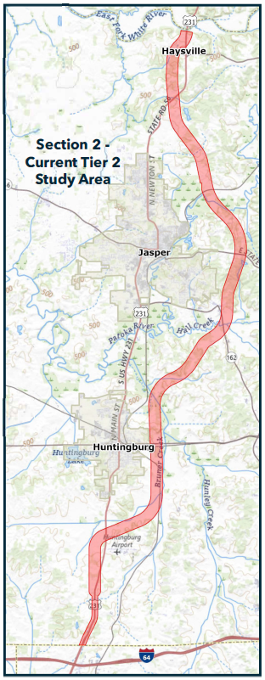
SECTION 2
Section of Independent Utility (SIU) 2
Tier 2 NEPA
Dubois County I-64 to SR 56
Preliminary design to
set and approve right of way
locate specific alignment
Determine facility type
Identify access locations and configurations
Develop local goals and identify community needs
Notes:
Here is the area currently being studied. Section 2 runs from I-64 to SR 56. During this phase of study we will perform environmental studies, engineering assessments, and develop preliminary designs to set the right-of-way and determine a specific alignment within the 2,000-foot-wide corridor.
The study will also determine a facility type – we’ll discuss that more in a moment.
Where to tie the new facility into local roads will also be determined
As well as developing local goals and community needs.

Slide 7
NEXT STEPS
Notes:
Let’s talk more about what to expect during the study of Section 2.

Slide 8
SECTION 2 FIRST STEPS
Initial Property Owner Coordination
Notice of Survey Letters to property owners in/near the 2,000 ft corridor
Individual owner contacts
Field Surveys and Data Collection
Public Outreach
Stakeholder Coordination
Community Advisory Committee
Kickoff Meeting
Notes:
Starting in July, we reached out to property owners in the corridor. Property owners have provided valuable information that will help inform the decision making process. The more information we receive, the better we understand usage and access needs.
Our field crews have been busy with data collection. They’re performing environmental and ecological surveys – plus mapping the location of things like buildings, trees, fences and drives.
Our project team is also collecting information from stakeholders and has met with our Community Advisory Committee. Our kickoff meeting allows us to collect contact information to keep you informed of future events and to receive your feedback.

Slide 9
WHAT’S NEXT
Notes:
Here’s a look at our anticipated timeline. The Section 2 study will take 3 years to complete.
During 2025 we will have public touchpoints as we develop the purpose and need and then create alignment variations or what we call alternatives.
From there, a draft document will be developed that recommends a preferred alternative and shares the data and analysis that went into that decision.
Comments and feedback from the public as well as state and federal review of the draft study will be used to create a final environmental document .

Slide 10
WHAT’S NEXT
Insert motion graphic of Super 2 and Expressway on top of 2,000-foot-wide-corridor
Notes:
A recommendation on a facility type will also be published in the draft study.
There are two options being studied: a Super 2 and an expressway.
You can see in the animation how the two variations fit within the 2,000 foot wide study area.

Slide 11
WHAT’S NEXT
Notes:
Here’s a cross section of the roadway. The Super 2 is a two lane road with periodic passing lanes and wide shoulders. The travel lanes and passing lane are 12 feet wide. The shoulders are 10 feet wide.

Slide 12
WHAT’S NEXT
Notes:
An expressway has two lanes in each direction, a wide median and wide shoulders. The travel lanes are each 12 feet. The shoulders are 10 feet wide. The median width varies.

Slide 13
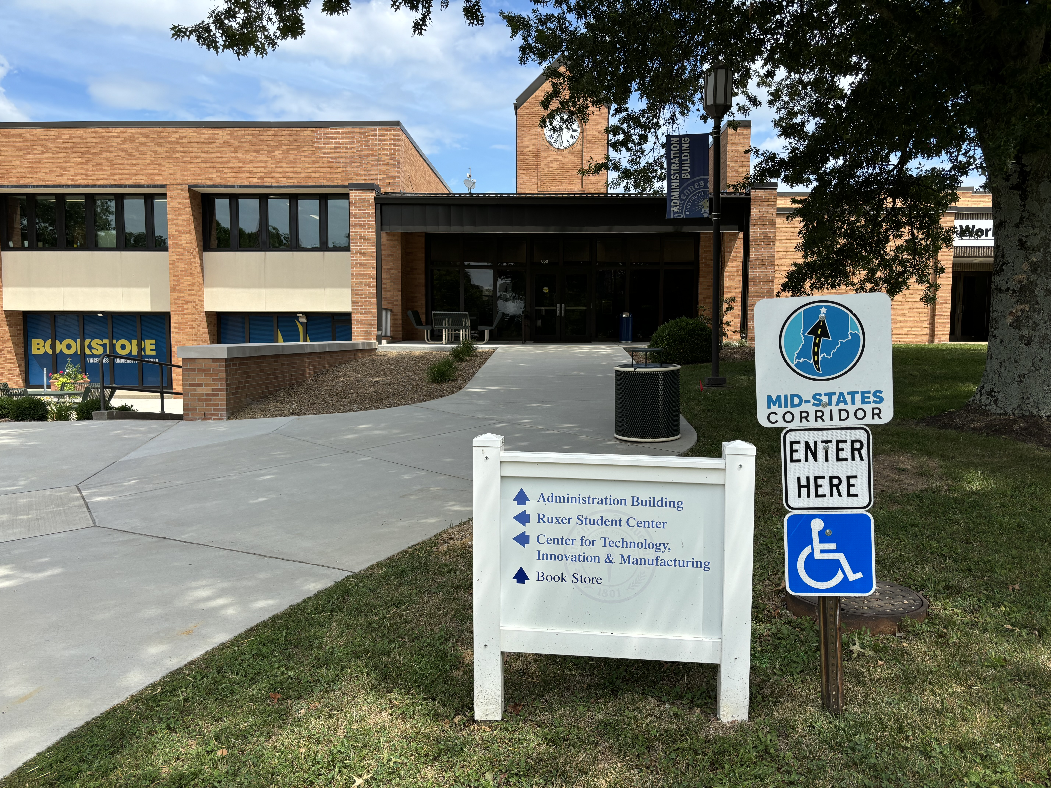
PROJECT OFFICE
Open: Tuesday and Thursday
9:00 a.m. to 4:00 p.m. ET (and by appointment)
Vincennes University Jasper Campus
Administration Building, Room 216
850 College Avenue
Jasper, IN 47546
812-482-3116
Notes:
We’ve reopened our project office to take your feedback and answer questions. Join us at the Administration Building on the Jasper campus of Vincennes University. We have office hours from 9 am to 4 pm on Tuesdays and Thursdays or by appointment.

Slide 14
STAY INFORMED
Notes:
Stay informed on the project. Check back to our website. We will be adding new material as the study progresses. Follow us on social media and sign up for text and email updates to be informed of future meetings.

Slide 15
Notes:
Thank you for your time and your interest in the Tier 2 Mid-States Corridor study in Section 2.

